Slide 1
Screening Gene Combinations for Neuronal Identification in C. elegans
2023-10-19

Slide 2

Gene Screening for Worms’ Neuronal Identification
To DISTINGUISH：
between neurons
 | ADA | ADE | ... | ADF | ADL | AFD | ... | SIB | SMB | SMD
WBGene00000042 | 0 | 0 | ... | 0 | 0 | 0 | ... | 1 | 1 | 1
WBGene00000044 | 0 | 0 | ... | 0 | 0 | 0 | ... | 0 | 0 | 0
... | 。。。
WBGene00000429 | 0 | 0 | ... | 0 | 0 | 0 | ... | 0 | 0 | 0
WBGene00000501 | 0 | 0 | ... | 1 | 0 | 0 | ... | 1 | 1 | 1
WBGene00000934 | 0 | 1 | ... | 0 | 0 | 0 | ... | 0 | 0 | 0
... | 。。。
WBGene00001135 | 1 | 0 | ... | 0 | 1 | 1 | ... | 0 | 0 | 0
WBGene00001444 | 0 | 0 | ... | 0 | 0 | 0 | ... | 0 | 0 | 0
To FIND:
gene combinations
Intuition: iterating over all possible gene combinations
$$C_{n}^{m}$$
where n represents the total number of candidate genes and m represents the number of genes in the combinations
e.g.
where 300 candidate genes and maximal number of the combinations is 8.

Slide 3
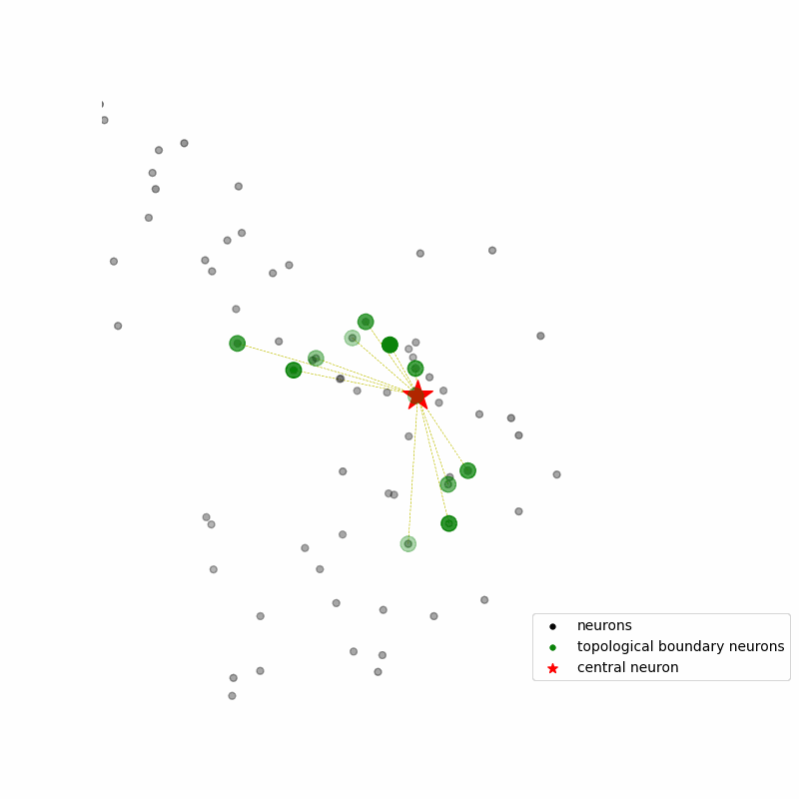
Optimization Strategy
Neruons:
Divide and Union by NeuroPAL
To reduce number of effective candidate genes, thus reducing computational effort
Question:
-L/R & -D/V
Distance & Variability
scRNA-Seq (13,669) & bulk RNA-Seq (part) * (22,289) |  | promoter reporter (796)
candidate reporter list from NeuroPAL (133)
Candidate Genes:
Stable and Diverse
To do:
to select available datasets
to screen suitable candidate genes
*: Seth R. Taylor, et al., Molecular topography of an entire nervous system. (2021). Cell 184, 4329–4347.

Slide 4
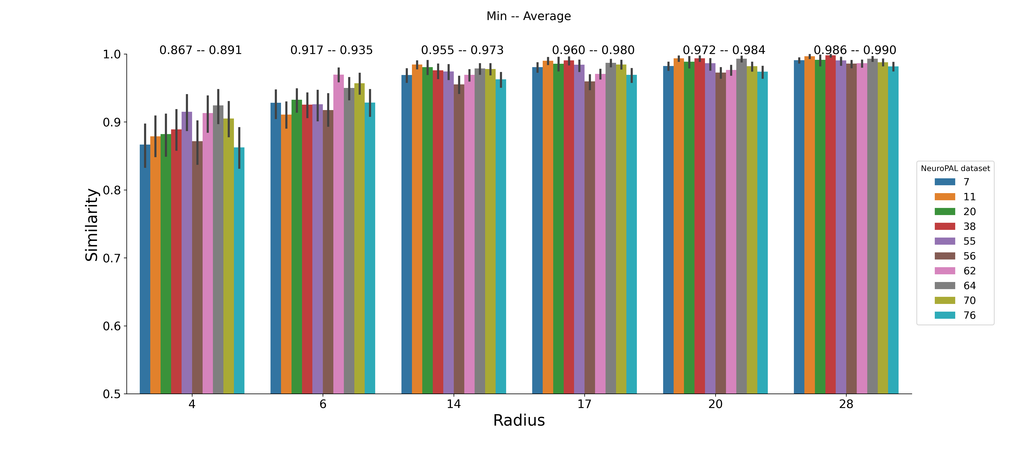
Neuron Classfication and Variability of Location
.
Neurons Type | represent neurons |  | *R/L neurons |  | *D/V* neurons
 | Neuron num. | average number of diff. genes | different neuron paris | average number of diff. genes | Neuron num. | average number of diff. genes
Diff. Num. | 85 | 57/796 | 1/54 | 6/796 | 18 | 4/796
In promoter dataset: the statistics as above
No distinguish: * R vs * L ; * D vs * V in scRNA Seq dataset.
2) .
NeuroPAL Datasets | 7 | 11 | 20 | 38 | 55 | 56 | 62 | 64 | 70 | 76
Nueuron num. | 185 | 190 | 191 | 188 | 190 | 188 | 185 | 187 | 191 | 186
Union | 195
cross validation
union of neuron sets between NeuroPAL datasts

Slide 5
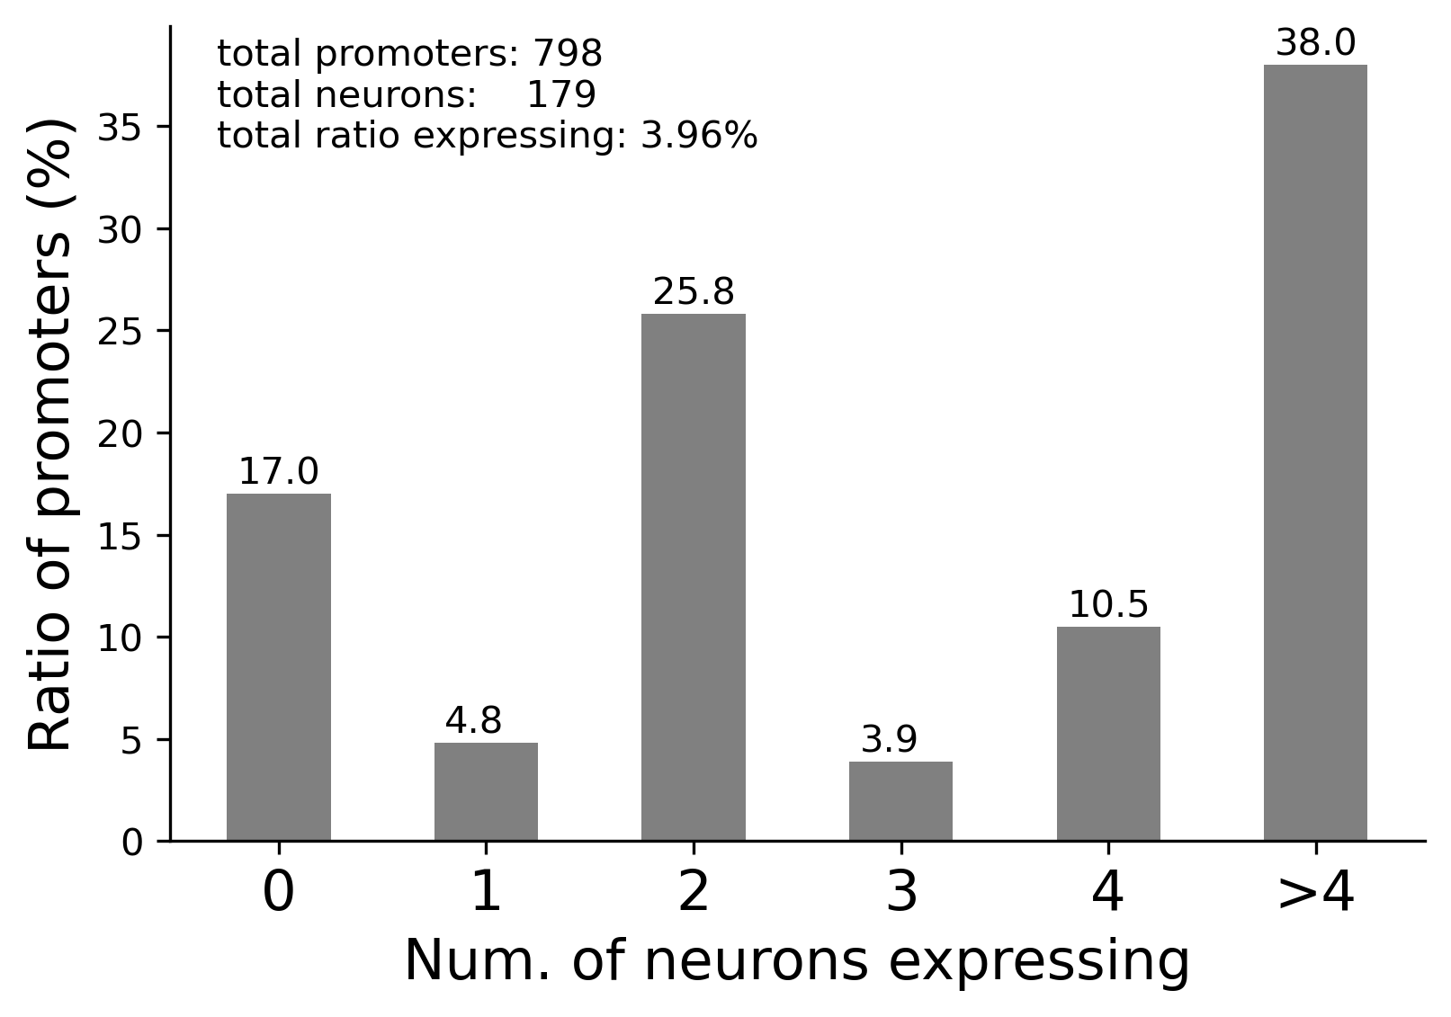
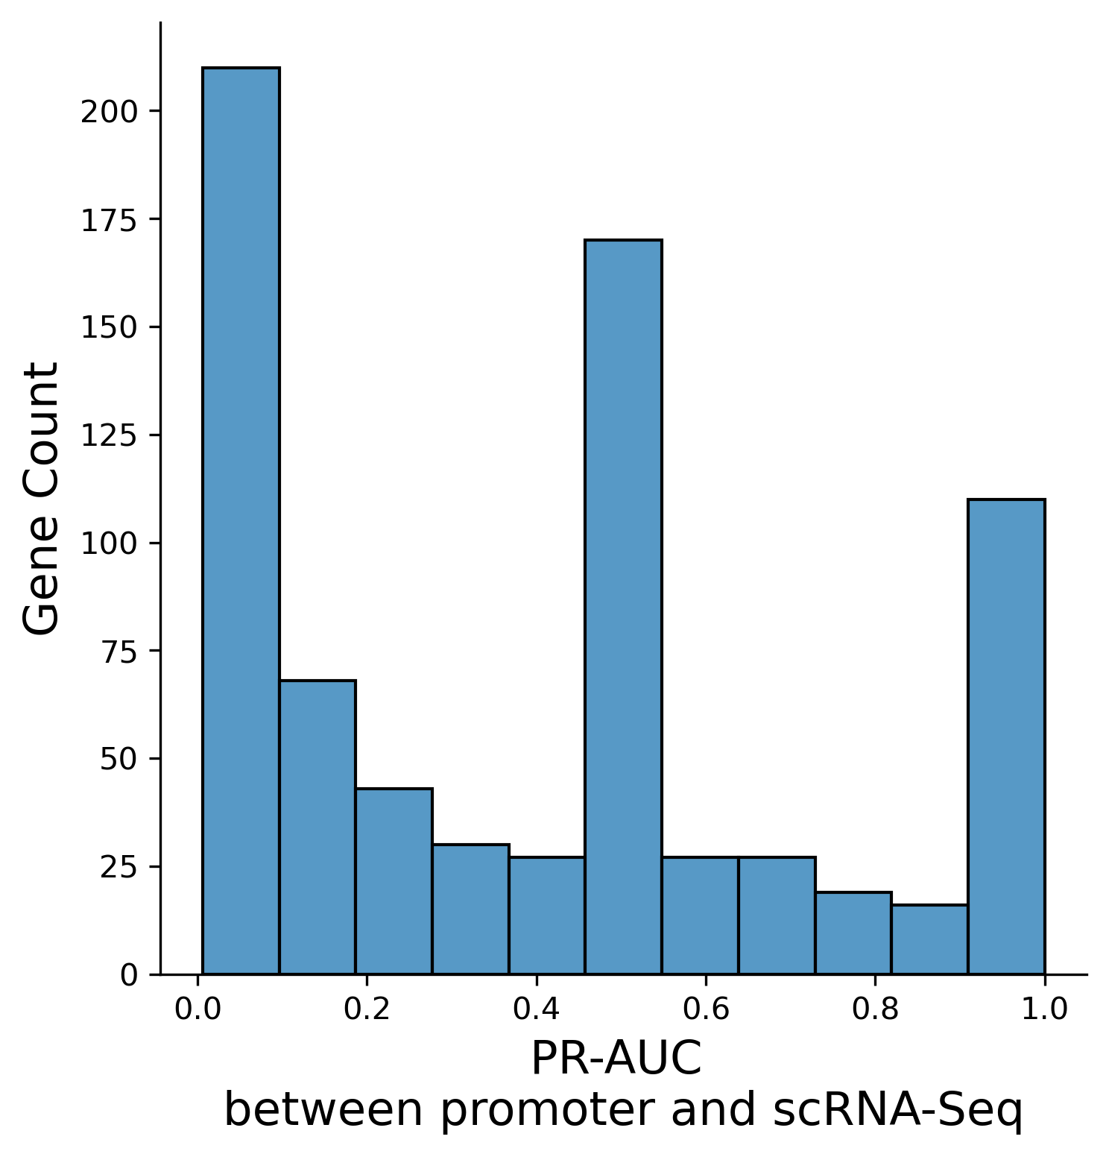
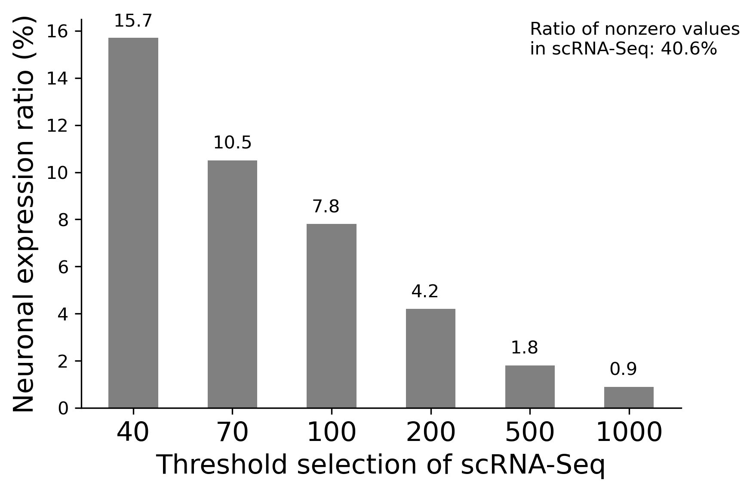
Available Screening Gene Expression Data
 | Promoter data | scRNA-Seq | NeuroPAL Reporters
Genes | 798 | 13,669 | 111(133 candidate reporters)
Neurons | 179 | 128 | 195
Data Type | 0-1 | continuous | None
Sparseness of the promoter data
Perfomance of 39 NeuroPAL Genes
Radius |  | promoter data | scRNA-Seq data (thv=70)
N6 | Total neuron pairs | 1786
 | unidentifiable neuron pairs | 41 | 4
N20 | Total neuron pairs | 3519
 | unidentifiable neuron pairs | 82 | 4
Threshold selection of the scRNA data

Slide 6
Parameters of Screening Gene Combinations
 | Candidate Genes | Radius | Neuron sets splited | Maximal gene combinations | Running processes | Time (Days) | Max. gene comb. screened
scRNA-Seq | 39 from NeuroPAL | N6 | 3,829 | 15 | 20 | < 1 | 7
 |  | N20 | 14,814 |  |  | < 1 | 6
 | 207 (111 + 130 PR-AUC>=0.8) | N6 | 3,829 | 9 | 20 | ~5 | 7
 |  | N20 | 14,814 | 6 |  | ~1.5 | 6
promoter | Not used
Result 1: 39 NeuroPAL Genes (minimal Union - exponential growth)
gene combn.
count
17:
27
18:
10
15:
1
18:
801
19:
2527
16:
23
19:
4716
20:
16729
17:
9
20:
2052
21:
22991
N6
18:
30
21:
6966
...
...
19:
28
22:
5904
supplemented with unidentifiable neuron pairs
23:
828
20:
4
21:
54
19:
2
22:
468
N20
20:
2
23:
468
21:
4
24:
414
N6
N20
Evaluation

Slide 7
Results of Screening Gene Combinations and Evaluation
Candidate genes: 207 (111 from NeuroPAL + 130 with PR-AUC >= 0.8)
Result 2:
supplemented with unidentifiable neuron pairs N20
15:
1
N6
14:
3
16:
76
17:
2346
18:
2646
N20
N6
N20
Evaluation
Result 3: based on neuron pair strategy — Efficiency Improvement. (From one week to less than 6 hours)
supplemented with unidentifiable neuron pairs N20
11:
17
10:
191
12:
1021
N6-10,000
13:
9082
11:
9809
14:
4066
11:
4
N20-1,000
12:
295
13:
701
N6
N20
Evaluation

Slide 8
Summary
The Logic of Code
num. gene combination | N6 | N20
Total | 22356 | 73866
10 | 191 | -
11 | 868 | 21
12 | - | 1441
13 | - | 16925
14 | 3 | 6987
15 | - | 491
16 | - | 74
17 | 27 | 2166
18 | 801 | 2592
19 | 4716 | 2527
20 | 2052 | 16729
21 | 6966 | 23033
22 | 5904 | 412
23 | 828 | 468
24 | - | 414
NeuroPAL Datasets
divide and union by distance
based on neuron pairs
neuron sets segmented
splitting and merging
+
final-neuron-sets
+
Screen data (candidate genes)
iteration & combinations
central neuron ID | gene combination | gene number | combination number
0 | [...] | N | M
deduplication +
union + unfold + minmal union
summary & evaluation
result

